Slide 1



Course: Data Mining
Bachelor Study Programme: Сomputer Science and Technology
Lesson 2:
Restoring missing values. Recommendation systems
Ass. prof. E. Pinevich

Slide 2
Learning Objectives
After studying this lesson, you will know:
Data tables often contain unfilled cells or cells with incorrect data.
The meaning of the correlation coefficient
The correlation coefficient can be used for data recovery.
Application of metrics and correlation coefficient in recommendation systems
The task of data recovery is used in the design of recommendation systems.
After studying this lesson, you should be able to:
Restore missing values.
Calculate the correlation coefficient between the columns and use it to restore the data.
Calculate user preferences in recommendation systems .
Bring the signs to the same scale.

Slide 3
ISSUE 1: What to do if the table is not fully filled or filled with incorrect values?
Student | Gender | Height | Weight | Blood type | Place at the Olympics
Ivanov | 1 | 175 | 700 | 2 | 3
Petrov | 1 | 180 | 75 | 3 | -1
Sidorova |  | 160 | 55 | 1 | 2
Smirnova | 0 |  | 65 | 4 | 4
What should you do (simple ways)?
Method 1. Delete a line (object).
Method 2. Delete a column (attribute).
Method 3. Replace the value in the cell with the average, median, or fashion
of the column values
Notes:
A microcontroller chip makes a substantially different use of the logic space available. Microcontrollers are heavily utilized in automation processes.
Another typical feature of a microcontroller is that it does not provide for human interaction. The microcontroller is programmed for a specific task, embedded in its device, and executes as and when required.
A microcontroller is a single chip that contains the processor,
non-volatile memory for the program (ROM), volatile memory for input and output
(RAM), a clock, and an I/O control unit
The processor portion of the microcontroller has a much lower silicon area than other microprocessors and much higher energy efficiency.

Slide 4
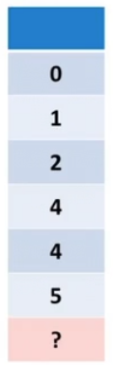
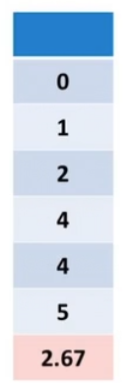
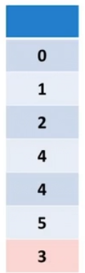
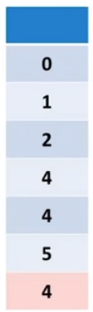
Example
average
median
fashion
Notes:
A microcontroller chip makes a substantially different use of the logic space available. Microcontrollers are heavily utilized in automation processes.
Another typical feature of a microcontroller is that it does not provide for human interaction. The microcontroller is programmed for a specific task, embedded in its device, and executes as and when required.
A microcontroller is a single chip that contains the processor,
non-volatile memory for the program (ROM), volatile memory for input and output
(RAM), a clock, and an I/O control unit
The processor portion of the microcontroller has a much lower silicon area than other microprocessors and much higher energy efficiency.

Slide 5
Сategorical signs
Using the mean, median, and mode, numerical features can be replaced.
But what about categorical signs?
The "gender" attribute of a person (0,0,0,1,1,?)
with a missing value.
Notes:
A microcontroller chip makes a substantially different use of the logic space available. Microcontrollers are heavily utilized in automation processes.
Another typical feature of a microcontroller is that it does not provide for human interaction. The microcontroller is programmed for a specific task, embedded in its device, and executes as and when required.
A microcontroller is a single chip that contains the processor,
non-volatile memory for the program (ROM), volatile memory for input and output
(RAM), a clock, and an I/O control unit
The processor portion of the microcontroller has a much lower silicon area than other microprocessors and much higher energy efficiency.

Slide 6
Nominal signs
What should you do with the nominal signs?
1. Replace the missing value with the mode (with O).
2. Generate 0 with probability 3/5 or 1 with a probability of 2/5.
Write the resulting value instead of skipping it.
3. Declare "gender" as a numeric attribute and apply recovery methods for numeric attributes to it.
Notes:
A microcontroller chip makes a substantially different use of the logic space available. Microcontrollers are heavily utilized in automation processes.
Another typical feature of a microcontroller is that it does not provide for human interaction. The microcontroller is programmed for a specific task, embedded in its device, and executes as and when required.
A microcontroller is a single chip that contains the processor,
non-volatile memory for the program (ROM), volatile memory for input and output
(RAM), a clock, and an I/O control unit
The processor portion of the microcontroller has a much lower silicon area than other microprocessors and much higher energy efficiency.

Slide 7
ISSUE 2: Correlation coefficient for data recovery
The meaning of the correlation coefficient (CC)
Сorrelation coefficient expresses how strongly the values of one feature affect the values of another feature (the measure of proximity of the features).
If metrics express the degree of proximity of objects, then the correlation coefficient expresses the degree of proximity of features.
Notes:
Data are recorded on and later retrieved from the disk via a conducting coil named
the head; in many systems, there are two heads, a read head and a write head
The write mechanism exploits the fact that electricity flowing through a coil
produces a magnetic field. Electric pulses are sent to the write head, and the resulting magnetic patterns are recorded on the surface below, with different patterns for
positive and negative currents.
The traditional read mechanism exploits the fact that a magnetic field moving
relative to a coil produces an electrical current in the coil. When the surface of the
disk rotates under the head, it generates a current of the same polarity as the one
already recorded. The structure of the head for reading is in this case essentially the
same as for writing, and therefore the same head can be used for both. Such single
heads are used in floppy disk systems and in older rigid disk systems.
The head is a relatively small device capable of reading from or writing to a portion
of the platter rotating beneath it.

Slide 8

Сorrelation coefficient and rationing
When using r in working with data, the signs may not be normalized.
The сorrelation coefficient will also not change when the scale of the features is changed and the features are translated into other units of measurement.
Notes:
One of the most significant developments in computer architecture in recent years is
the increasing use of solid state drives (SSDs)
The term solid state refers to electronic circuitry built with semiconductors
The SSDs now on the market and coming on line use NAND flash
memory,

Slide 9
Data recovery using other columns
Woman | Chest | Waist | Hips | Height | Weight
1 | 99 | 56 | 91 | 160 | 58
2 | 89 | 58 | 89 | 157 | 48
3 | 91 | 64 | 91 | 165 | 54
4 | 91 | 51 | 91 | 170 | 54
5 | 86 | 56 | 84 | 157 | 44
6 | 97 | 53 | 86 | 175 | 56
7 | ? | 51 | 91 | 165 | 54
 | Аverage
Chest | 92,17
Waist | 56,33
Hips | 88,67
Height | 164
Weight | 52,33
It is necessary to calculate for each column its average and the correlation coefficient of all columns with the 1st column (without using the last row).
Notes:
This gives rise to the organization of data on the
platter in a concentric set of rings, called tracks.
Each track is the same width as the
head. There are thousands of tracks per surface
Adjacent tracks are separated by inter track
gaps.
This prevents, or at least minimizes, errors due to misalignment of the head
or simply interference of magnetic fields.
Data are transferred to and from the disk
in sectors.
There are typically hundreds of sectors per track, and these may be of
either fixed or variable length.
In most contemporary systems, fixed-length sectors
are used.
To avoid imposing unreasonable precision requirements on the system,
adjacent sectors are separated by intersector gaps
The information can then be scanned at the same rate by rotating the
disk at a fixed speed, known as the constant angular velocity (CAV)

Slide 10
Correlation coefficients
r (Chest, Waist) = -0.22
r (Chest, Hips) = 0.34
r (Chest, Height) = 0.46
r (Chest, Weight) = 0,91
The point is, a trait with a large modulus of сorrelation coefficient has a greater impact on the trait being restored.
Notes:
Table lists the major characteristics that differentiate the various types of magnetic disks.
First, the head may either be fixed or movable with respect to the radial
direction of the platter. In a fixed-head disk, there is one read-write head per track.
All of the heads are mounted on a rigid arm that extends across all tracks; such
systems are rare today. In a movable-head disk, there is only one read-write head.
Again, the head is mounted on an arm. Because the head must be able to be positioned above any track, the arm can be extended or retracted for this purpose.
The disk itself is mounted in a disk drive, which consists of the arm, a spindle
that rotates the disk, and the electronics needed for input and output of binary data.
A nonremovable disk is permanently mounted in the disk drive; the hard disk in
a personal computer is a nonremovable disk. A removable disk can be removed
and replaced with another disk. The advantage of the latter type is that unlimited
amounts of data are available with a limited number of disk systems. Furthermore,
such a disk may be moved from one computer system to another. Floppy disks and
ZIP cartridge disks are examples of removable disks.
For most disks, the magnetizable coating is applied to both sides of the platter, which is then referred to as double sided. Some less expensive disk systems use single-sided disks.
Some disk drives accommodate multiple platters stacked vertically a fraction
of an inch apart. Multiple arms are provided

Slide 11

The smart formula
Let P(A) be the value of the attribute P of the object A.
P is the average value of the attribute R.
It is required to determine P(A) by feature columns P1,P2,…,Pm.
Note: in the formula, all values are calculated without taking into account the row of object A.
Notes:
With the use of multiple disks, there is a wide variety of ways in which the data
can be organized and in which redundancy can be added to improve reliability. This
could make it difficult to develop database schemes that are usable on a number of
platforms and operating systems. Fortunately, industry has agreed on a standardized scheme for multiple-disk database design, known as RAID (Redundant Array
of Independent Disks)

Slide 12
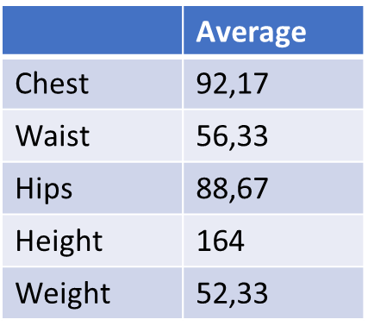
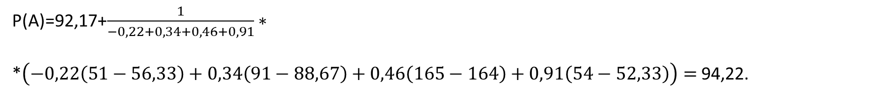
Example
А | ? | 51 | 91 | 165 | 54
r (Chest, Waist) = - 0.22
r (Chest, Hips) = 0.34
r (Chest, Height) = 0.46
r (Chest, Weight) = 0,91
P(A)=92,17+$\frac{1}{−0,22+0,34+0,46+0,91}∗$
*$\left(−0,22\left(51−56,33\right)+0,34\left(91−88,67\right)+0,46\left(165−164\right)+0,91\left(54−52,33\right)\right)=$ 94,22.

Slide 13
Applying сorrelation coefficients to strings
To do this, calculate the CC of the row with the omission and the remaining rows of the table.
Using a similar formula, restore the missing value.
Woman | Chest | Waist | Hips | Height | Weight
1 | 99 | 56 | 91 | 160 | 58
2 | 89 | 58 | 89 | 157 | 48
3 | 91 | 64 | 91 | 165 | 54
4 | 91 | 51 | 91 | 170 | 54
5 | 86 | 56 | 84 | 157 | 44
6 | 97 | 53 | 86 | 175 | 56
7 | ? | 51 | 91 | 165 | 54
Notes:
In the case of disk storage, this leads to the development of arrays of disks that operate independently and in parallel. With
multiple disks, separate I/O requests can be handled in parallel, as long as the data
required reside on separate disks. Further, a single I/O request can be executed in
parallel if the block of data to be accessed is distributed across multiple disks

Slide 14
ISSUE 3: Application of metrics and correlation coefficient in recommendation systems
The recommendation system (RS) is a table: rows correspond to users, columns correspond to products,
in (i,j)-cell there is a rating that the i-th user has set the j-th product (the cell may be empty if there was no evaluation).
Person | ChupaChups | Doshirak | Hawthorn | VAZ 2101 | Seeds
A | 3 | 4 | 5 | 3 | 4
B | 5 | 5 | 5 | 4 | 3
C | 4 | 3 | 3 | 2 | 5
D | 5 | 4 | 3 | 3 | ?
Notes:
1. The entire block must be read from the flash memory and placed in a RAM
buffer. Then the appropriate page in the RAM buffer is updated.
2. Before the block can be written back to flash memory, the entire block of flash
memory must be erased—it is not possible to erase just one page of the flash
memory.
3. The entire block from the buffer is now written back to the flash memory

Slide 15
Omissions in the tables
There may be gaps in such tables.
For example, Person D did not rate such a product as sunflower seeds.
Person | ChupaChups | Doshirak | Hawthorn | VAZ 2101 | Seeds
A | 3 | 4 | 5 | 3 | 4
B | 5 | 5 | 5 | 4 | 3
C | 4 | 3 | 3 | 2 | 5
D | 5 | 4 | 3 | 3 | ?
The recommendation system should understand whether person D likes the product or not.
Notes:
In 1983, one of the most successful consumer products of all time was introduced: the
compact disk (CD) digital audio system.

Slide 16
Recommendation systems
Predicting the score in the recommendation system actually means restoring the data in the table
Person | ChupaChups | Doshirak | Hawthorn | VAZ 2101 | Seeds
A | 3 | 4 | 5 | 3 | 4
B | 5 | 5 | 5 | 4 | 3
C | 4 | 3 | 3 | 2 | 5
D | 5 | 4 | 3 | 3 | ?
If the score is high, the system will recommend the product to person D, if the score is low, the system will not recommend the product to person D.
We have reviewed the system with anonymous users.
But what about recommendations if users are anonymous?
Notes:
Information is retrieved from a CD or CD- ROM by a low- powered laser
housed in an optical- disk player, or drive unit. The laser shines through the clear
polycarbonate while a motor spins the disk past it

Slide 17
Recommendation systems with anonymous users
What should we do when the service (site) is visited by anonymous users?
In this case, how to determine the distance between users (products)?
Products | Order numbers 1 2 3 4 5 6 7 8 9
A | 1 | 1 | 0 | 0 | 1 | 1 | 0 | 0 | 0
B | 0 | 1 | 0 | 0 | 1 | 0 | 1 | 1 | 0
C | 0 | 0 | 0 | 1 | 1 | 0 | 1 | 0 | 1
RS with anonymous users more formally: the sign P=1 if the product was included in the order with the number i (otherwise P=0).
Now you can count the distances between the rows of the table.
This will be a measure of the proximity of goods to each other.
Notes:
You can do it in writing and send me on the email:

Slide 18
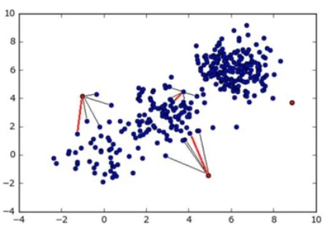
Different scales of signs
Student | Height (m) | Weight (kg)
Shatilov | 1,75 | 75
Suprun | 1,82 | 85
Matsak | 1,69 | 65
Often objects are represented by points in the feature space and the distance between them is considered (metric).
It is necessary that the scale of the features on all axes be the same
Notes:
You can do it in writing and send me on the email:

Slide 19
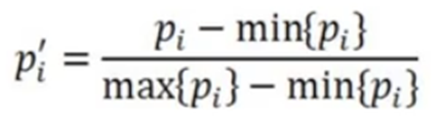
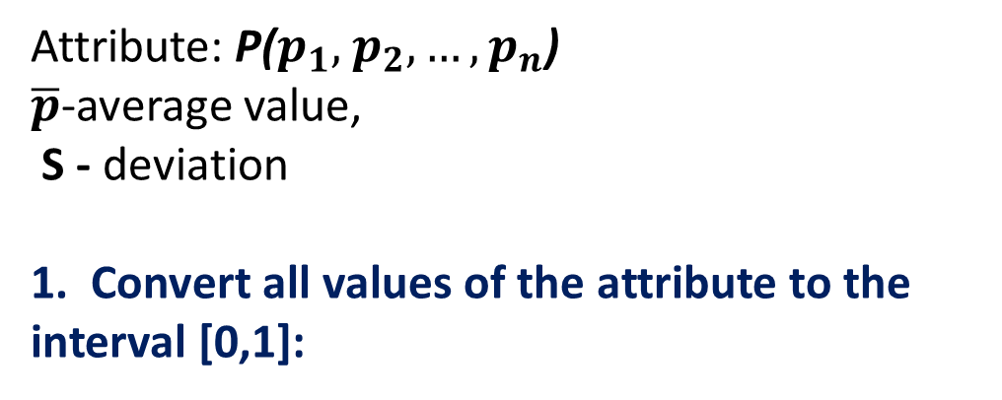
Ways of rationing features
Attribute: P($p_{1},$ $p_{2},…,p_{n}$)
$\overline{p}$-average value,
S - deviation
1. Convert all values of the attribute to the interval [0,1]:
After applying this formula, the minimum values of p are guaranteed to go to 0, and the maximum values will go to 1. All other values will be placed in the interval [0,1]
Notes:
You can do it in writing and send me on the email:

Slide 20

Ways of rationing features
2. Perform the convertion:
After that, the average value and deviation of the attribute P will be 0 and 1, respectively.
Notes:
You can do it in writing and send me on the email:

Slide 21
Ways of rationing features
3. Logarithm
In addition to the formulas from methods 1-2, different functions can be pre-applied to the features(for example, log).
If the attribute has values of 1,10,100,..., then the difference between the values is very different. After the logarithm, we get a more compact numerical series
For example, with base 10 logarithm of 1 will go to 0, 10 will go to 1, 100 will go to 2.
Notes:
You can do it in writing and send me on the email:

Slide 22
Key Terms
average median fashion сorrelation coefficient metric mean value | feature sign trait attribute omission rationing | nominal signs categorical signs missing values binary attribute nominal trait ordinal sign data recovery anonymous users recommendation systems rationing features

